Slide 1
GNUstep: Concrete Architecture
https://www.youtube.com/watch?v=aGMgzn9B5Vk

Slide 2
Task Distribution
Kamana Chapagain (Group Leader) | Introduction, Use Cases, Lessons Learned
Sareena Shrestha (Presenter #1) | Top-Level Conceptual Architecture, Top-Level Concrete Architecture
Shreya Menon (Presenter #2) | Derivation Process, Conclusion
Yashasvi Pradhan | Reflexion Analysis of Chosen 2nd-Level Subsystem, Concurrency
Justin Li | Reflexion Analysis of High-Level Architecture
Saachi Singh | Abstract, libs-back Conceptual Architecture

Slide 3
Table of contents
01
02
03
04
05
06
07
08
09
10
11
12
High-Level Conceptual Architecture
Derivation Process
High-Level Concrete Architecture
High-Level Reflexion Analysis
Second-Level Conceptual Architecture
Second-Level Concrete Architecture
Second-Level Reflexion Analysis
Use Case
Conclusion
Effects of Concurrency
Team Issues + Limitations
Lessons Learned

Slide 4
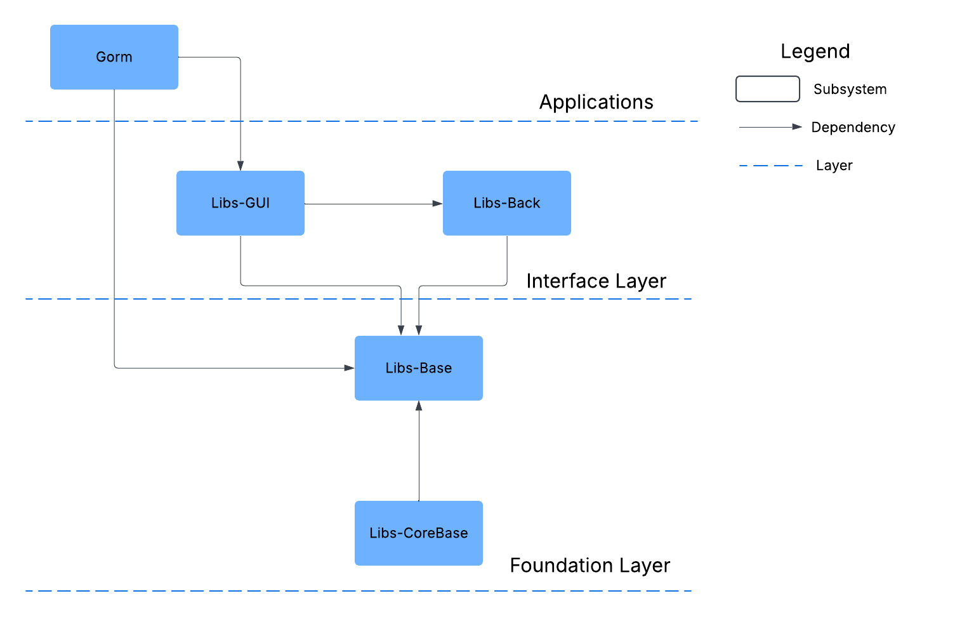
High-Level Conceptual Architecture

Slide 5
Derivation Process
Research and Discoveries
Updated Dependency Diagram
Architectural Choices
Each team member independently worked on examining the system’s structure using the Understand tool before consolidating our findings and refining them as a group.
Identified an additional key subsystem, libobjc2.
Also discovered several bidirectional dependencies.
Considered Alternative: Event-Driven.
Final consensus: Layered and object-oriented architectural style.
Layered:
Higher-level libraries build on lower-level ones
Object-Oriented:
Consistent use of Objective-C classes and modular components.
Added newly discovered dependencies between subsystems.
Added libobjc2 as a main subsystem.

Slide 6
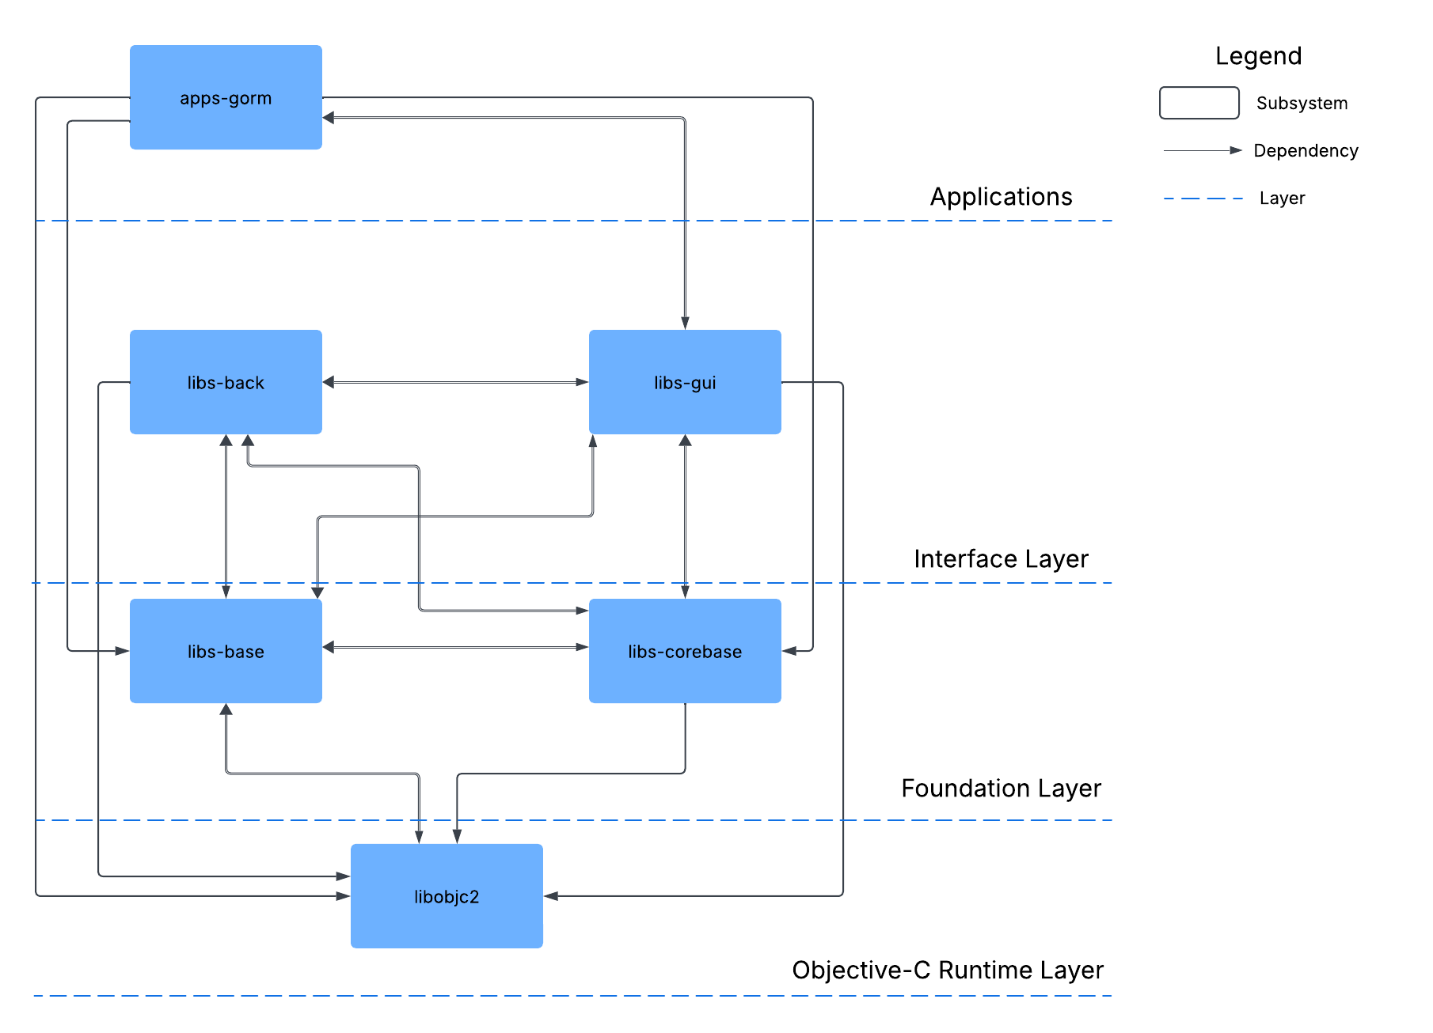
High-Level Concrete Architecture

Slide 7
High-Level Concrete Architecture

Slide 8
High-Level Concrete Architecture

Slide 9
High-Level Concrete Architecture

Slide 10
High-Level Concrete Architecture

Slide 11
High-Level Concrete Architecture

Slide 12
High-Level Concrete Architecture

Slide 13
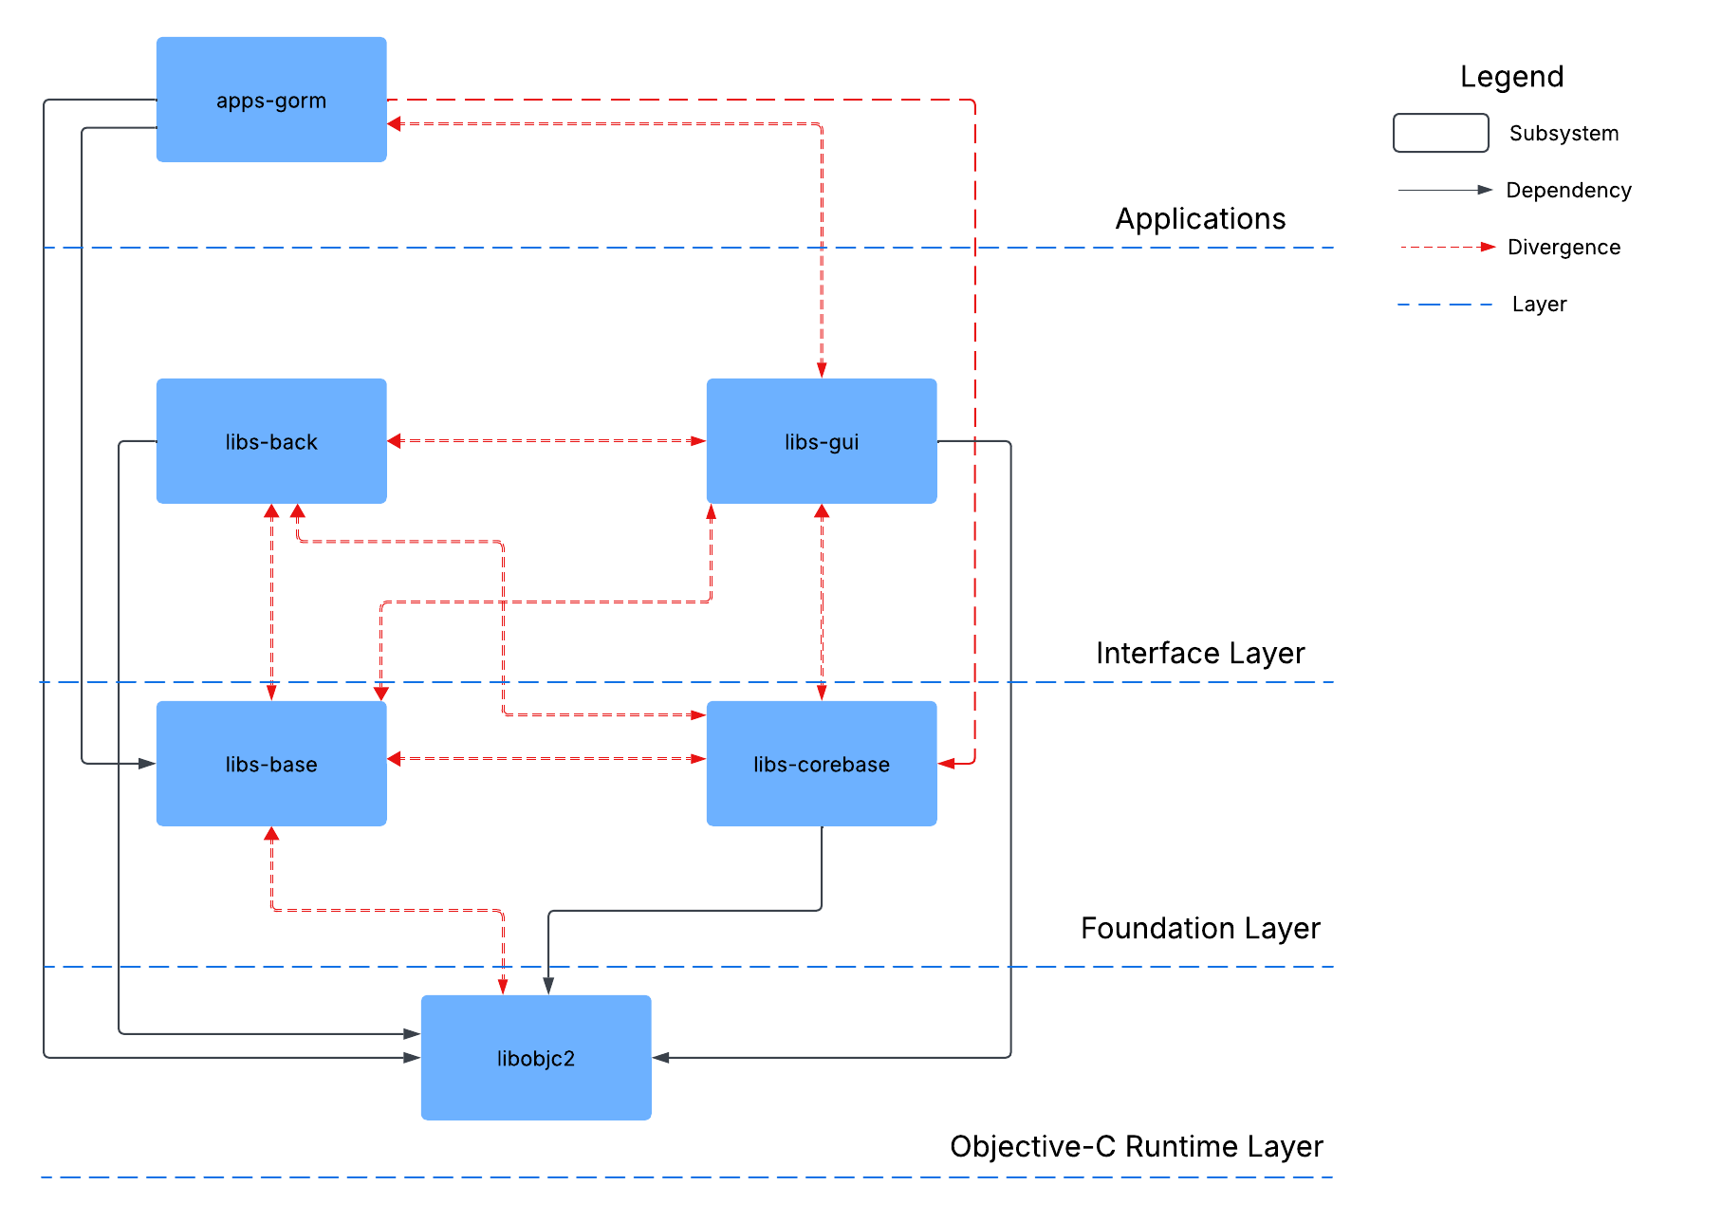
Reflexion Analysis of High-Level Concrete Architecture

Slide 14
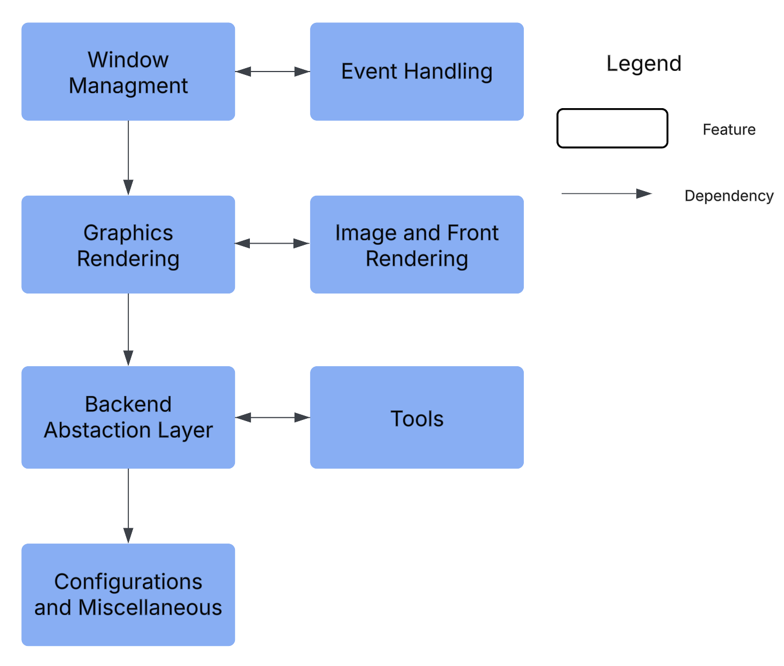
libs-back conceptual architecture

Slide 15
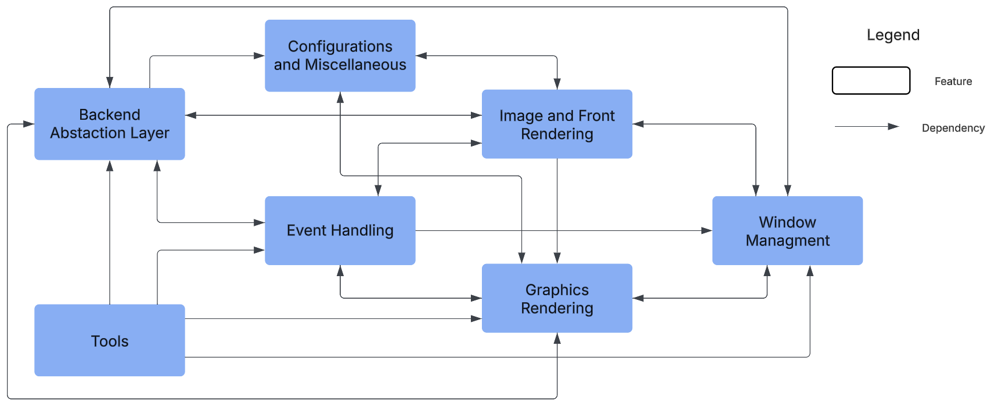
libs-back concrete architecture

Slide 16
Reflexion Analysis

Slide 17
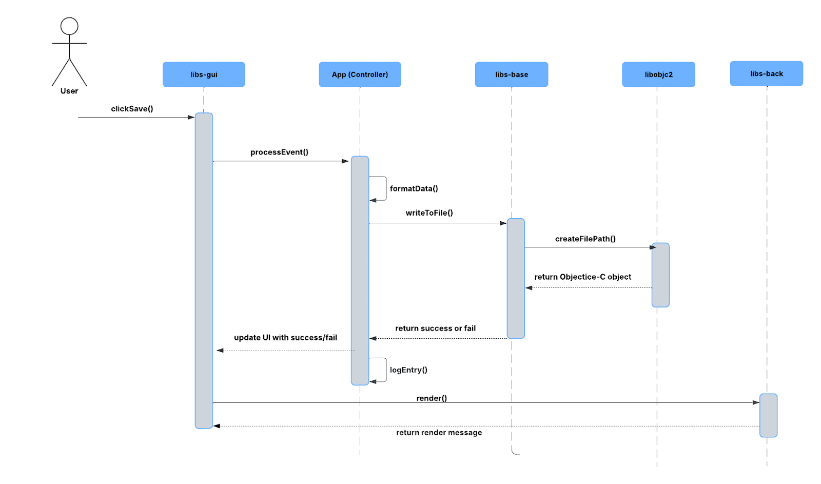
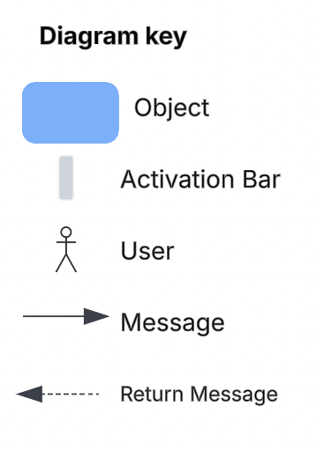
Use Case

Slide 18
Effects Of Concurrency
Multi-Threaded Architecture
Synchronization mechanisms
Problems Faced

Slide 19
Team Issues & Limitations
Using the Understand tool
Available documentation
Unexpected dependencies

Slide 20
Lessons Learned
Interdependent Sections
Time Delays
Starting Early

Slide 21
Conclusion

